Slide 1
物件導向設計
Defining Class
授課教師:陳錫民
Email: hsiminc@fcu.edu.tw

Slide 2
Introduction
Classes are the most important language feature that make object-oriented programming (OOP) possible
Programming in Java consists of defining a number of classes
Every program is a class
All helping software consists of classes
All programmer-defined types are classes
Classes are central to Java

Slide 3
Class Definitions
You already know how to use classes and the objects created from them, and how to invoke their methods
For example, you have already been using the predefined String and Scanner classes
Now you will learn how to define your own classes and their methods, and how to create your own objects from them

Slide 4
A Class Is a Type
A class is a special kind of programmer-defined type
Variables can be declared of a class type
A value of a class type is called an object or an instance of the class
If A is a class, then the phrases "bla is of type A," "bla is an object of the class A," and "bla is an instance of the class A" mean the same thing
A class determines
the types of data that an object can contain
the actions it can perform

Slide 5
Primitive Type Values vs. Class Type Values
A primitive type value is a single piece of data
A class type value or object can have multiple pieces of data, as well as actions called methods
All objects of a class have the same methods
All objects of a class have the same pieces of data (i.e., name, type, and number)
For a given object, each piece of data can hold a different value

Slide 6
The Contents of a Class Definition
A class definition specifies the data items and methods that all of its objects will have
These data items and methods are sometimes called members of the object
Data items are called attributes, fields or instance variables
Instance variable declarations and method definitions can be placed in any order within the class definition

Slide 7
Class Diagram
Class Name
Variable 1
:
Variable n
Method 1
:
Method 2

Slide 8


Class versus Object
Class
Object
Psyduck
name
weight
height
hp
powerup
evolve

Slide 9
Design to Implementation
public class Psyduck {
private String name;
public float weight;
public float height;
public int hp;
public void powerup() {
}
public void evolve () {
}
}
Psyduck
- name: String
+ weight: float
+ height: float
+ hp: int
+ powerup ()
+ evolve ()

Slide 10
Instance Variables
Instance variables can be defined as in the following two examples
Note the public modifier (for now):
public String instanceVar1;
public int instanceVar2;

Slide 11
Instance Variables
public class Psyduck {
private String name;
public float weight;
public float height;
public int hp;
public void powerup() {
}
public void evolve () {
}
}

Slide 12
Methods
Method definitions are divided into two parts: a heading and a method body:
public void myMethod() { Heading
code to perform some action Body
and/or compute a value
}

Slide 13
Methods
public class Psyduck {
private String name;
public float weight;
public float height;
public int hp;
public void powerup() {
System.out.println(”power up”);
}
public void evolve () {
System.out.println(”evolve”);
}
}

Slide 14
File Names
Reminder: a Java file must be given the same name as the class it contains with an added .java at the end
For example, a class named Psyduck must be in a file named Psyduck.java

Slide 15
The new Operator
An object of a class is named or declared by a variable of the class type:
ClassName classVar;
The new operator must then be used to create the object and associate it with its variable name:
classVar = new ClassName();
These can be combined as follows:
ClassName classVar = new ClassName();

Slide 16
The new Operator
public class Psyduck {
private String name;
public float weight;
public float height;
public int hp;
public void powerup() {
System.out.println(”power up”);
}
public void evolve () {
System.out.println(”evolve”);
}
}
public class Main{
public static void main(String[] args) {
Psyduck duck1 = new Psyduck();
}
}

Slide 17
Method Invocations
Methods are invoked using the name of the calling object and the method name as follows:
classVar.myMethod();
Invoking a method is equivalent to executing the method body

Slide 18
Method Invocations
public class Psyduck {
private String name;
public float weight;
public float height;
public int hp;
public void powerup() {
System.out.println(”power up”);
}
public void evolve () {
System.out.println(”evolve”);
}
}
public class Main{
public static void main(String[] args) {
Psyduck duck1 = new Psyduck();
duck1.powerup();
}
}

Slide 19
More About Methods
There are two kinds of methods:
Methods that compute and return a value
Methods that perform an action
This type of method does NOT return a value, and is called a void method
Each type of method differs slightly in how it is defined as well as how it is (usually) invoked

Slide 20
More About Methods
A method that returns a value must specify the type of that value in its heading:
public typeReturned methodName(paramList)
A void method uses the keyword void in its heading to show that it does not return a value :
public void methodName(paramList)

Slide 21
Two kinds of Methods
public class Psyduck {
private String name;
public float weight;
public float height;
public int hp;
public int powerup() {
System.out.println(”power up”);
hp = hp +100;
return hp;
}
public void evolve () {
System.out.println(”evolve”);
weight = weight + 5;
height = height +10;
}
}

Slide 22
main is a void Method
A program in Java is just a class that has a main method
When you give a command to run a Java program, the run-time system invokes the method main
Note that main is a void method, as indicated by its heading:
public static void main(String[] args)

Slide 23
main is a void Method
public class Psyduck {
private String name;
public float weight;
public float height;
public int hp;
public void powerup() {
System.out.println(”power up”);
}
public void evolve () {
System.out.println(”evolve”);
}
}
public class Main{
public static void main(String[] args) {
Psyduck duck1 = new Psyduck();
duck1.powerup();
}
}

Slide 24
return Statements
The body of both types of methods contains a list of declarations and statements enclosed in a pair of braces
public <void or typeReturned> myMethod()
{
declarations
statements
}
Body

Slide 25
return Statements
The body of a method that returns a value must also contain one or more return statements
A return statement specifies the value returned and ends the method invocation:
return Expression;
Expression can be any expression that evaluates to something of the type returned listed in the method heading

Slide 26
return Statements
A void method need NOT contain a return statement,
unless there is a situation that requires the method to end before all its code is executed
In this context, since it does not return a value, a return statement is used without an expression:
return;

Slide 27
return Statements
public class Psyduck {
private String name;
public float weight;
public float height;
public int hp;
public int powerup() {
:
}
public void evolve () {
System.out.println(”evolve”);
if(weight > 100) {
return;
}
weight = weight + 5;
height = height +10;
}
}

Slide 28
Method Definitions
An invocation of a method that returns a value can be used as an expression anyplace that a value of the typeReturned can be used:
typeReturned tRVariable;
tRVariable = objectName.methodName();
An invocation of a void method is simply a statement:
objectName.methodName();

Slide 29
Method Definitions
public class Psyduck {
private String name;
public float weight;
public float height;
public int hp;
public int powerup() {
System.out.println(”power up”);
hp = hp +100;
return hp;
}
public void evolve () {
System.out.println(”evolve”);
weight = weight + 5;
height = height +10;
}
}
public class Main{
public static void main(String[] args) {
Psyduck duck1 = new Psyduck();
int hp = 0;
hp = duck1.powerup();
// int hp = duck1.powerup();
}
}

Slide 30
Any Method Can Be Used As a void Method
A method that returns a value can also perform an action
If you want the action performed, but do not need the returned value, you can invoke the method as if it were a void method, and the returned value will be discarded:
objectName.returnedValueMethod();

Slide 31
Local Variables
A variable declared within a method definition is called a local variable
All variables declared in the main method are local variables
All method parameters are local variables
If two methods each have a local variable of the same name, they are still two entirely different variables

Slide 32
Local Variables
public class Psyduck {
private String name;
public float weight;
public float height;
public int hp;
public int powerup() {
int increase = 100;
hp = hp + increase;
return hp;
}
public void evolve () {
System.out.println(”evolve”);
weight = weight + 5;
height = height +10;
}
}

Slide 33
Global Variables
Some programming languages include another kind of variable called a global variable
The Java language does NOT have global variables

Slide 34
Blocks
A block is another name for a compound statement, that is, a set of Java statements enclosed in braces,{}
A variable declared within a block is local to that block, and CANNOT be used outside the block
Once a variable has been declared within a block, its name cannot be used for anything else within the same method definition

Slide 35
Blocks
public class Psyduck {
private String name;
public float weight;
public float height;
public int hp;
public int powerup() {
int increase = 100;
hp = hp + increase;
return hp;
}
public void evolve () {
System.out.println(”evolve”);
weight = weight + 5;
height = height +10;
}
}

Slide 36
Declaring Variables in a for Statement
You can declare one or more variables within the initialization portion of a for statement
A variable so declared will be local to the for loop, and cannot be used outside of the loop
If you need to use such a variable outside of a loop, then declare it outside the loop

Slide 37
Parameters of a Primitive Type
The methods seen so far have had no parameters, indicated by an empty set of parentheses in the method heading
Some methods need to receive additional data via a list of parameters in order to perform their work

Slide 38
Parameters of a Primitive Type
A parameter list provides a description of the data required by a method
It indicates the number and types of data pieces needed, the order in which they must be given, and the local name for these pieces as used in the method
public double myMethod(int p1, int p2, double p3)

Slide 39
Parameters of a Primitive Type
When a method is invoked, the appropriate values must be passed to the method in the form of arguments
The number and order of the arguments must exactly match that of the parameter list
The type of each argument must be compatible with the type of the corresponding parameter
int a=1,b=2,c=3;
double result = myMethod(a,b,c);

Slide 40
Parameters of a Primitive Type
In the preceding example, the value of each argument (not the variable name) is plugged into the corresponding method parameter
This method of plugging in arguments for formal parameters is known as the call-by-value mechanism

Slide 41
Parameters of a Primitive Type
If argument and parameter types do not match exactly, Java will attempt to make an automatic type conversion
In the preceding example, the int value of argument c would be cast to a double
A primitive argument can be automatically type cast from any of the following types, to any of the types that appear to its right:
byte→short→int→long→float→double
char

Slide 42
Parameters of a Primitive Type
A parameters is often thought of as a blank or placeholder that is filled in by the value of its corresponding argument
However, a parameter is more than that: it is actually a local variable
When a method is invoked, the value of its argument is computed, and the corresponding parameter (i.e., local variable) is initialized to this value
Even if the value of a formal parameter is changed within a method (i.e., it is used as a local variable) the value of the argument cannot be changed

Slide 43
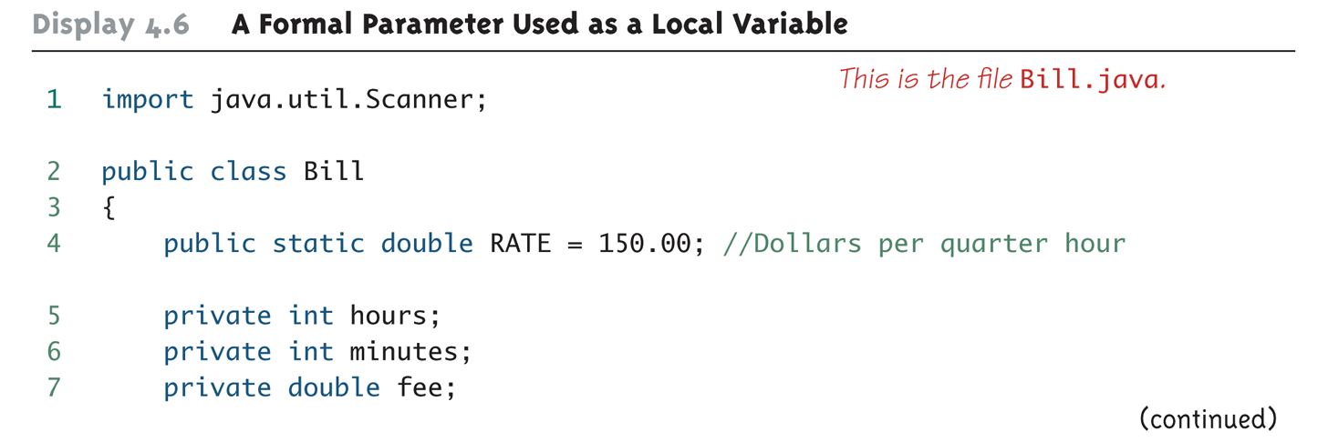
A Formal Parameter Used as a Local Variable (Part 1 of 5)

Slide 44
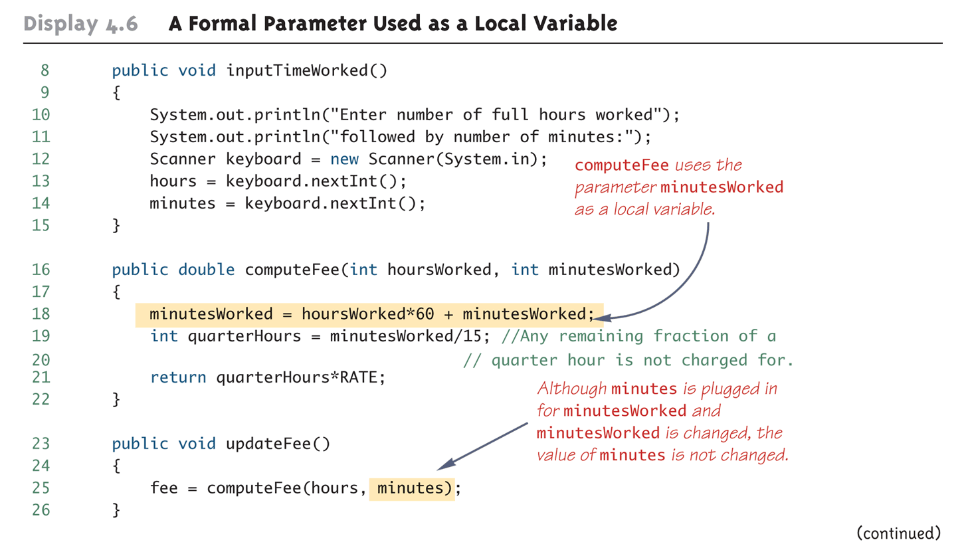
A Formal Parameter Used as a Local Variable (Part 2 of 5)

Slide 45
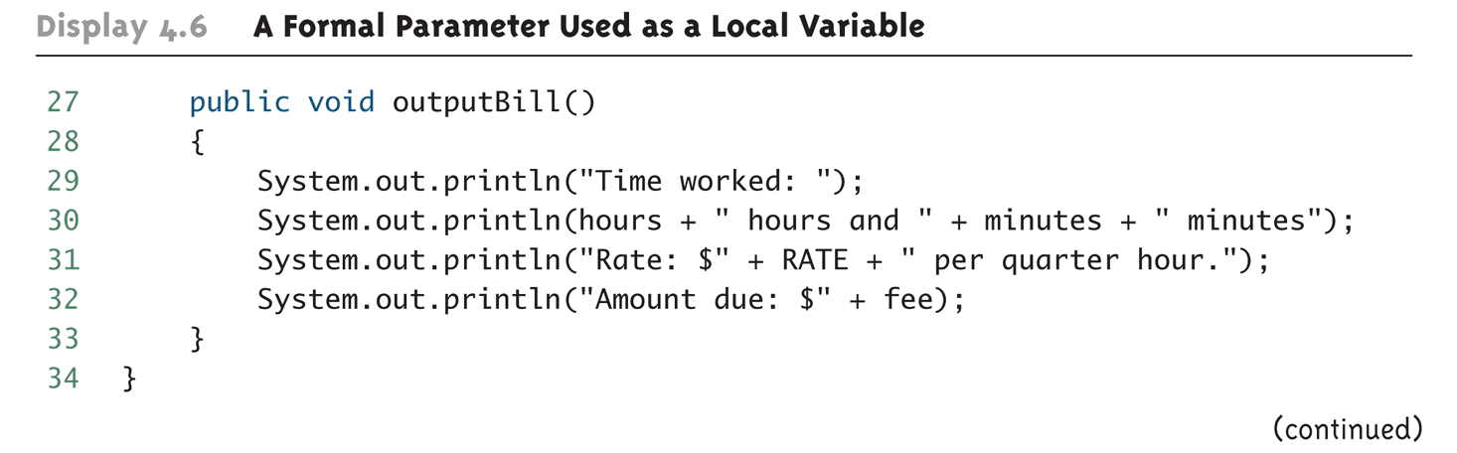
A Formal Parameter Used as a Local Variable (Part 3 of 5)

Slide 46
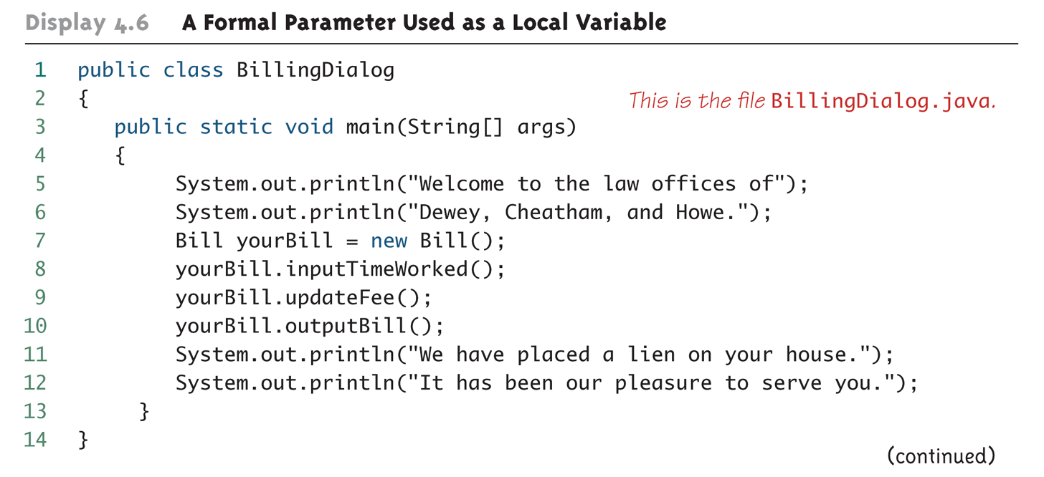
A Formal Parameter Used as a Local Variable (Part 4 of 5)

Slide 47
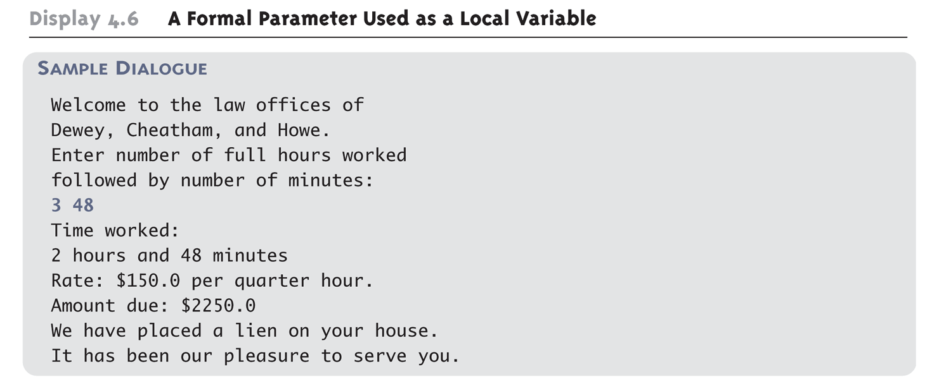
A Formal Parameter Used as a Local Variable (Part 5 of 5)

Slide 48
Pitfall: Use of the Terms "Parameter" and "Argument"
Parameter is the variable and argument is the item passed in
Do not be surprised to find that people often use the terms parameter and argument interchangeably
When you see these terms, you may have to determine their exact meaning from context

Slide 49
The this Parameter
All member variables are understood to have <the calling object>. in front of them
If an explicit name for the calling object is needed, the keyword this can be used
myInstanceVariable always means and is always interchangeable with this.myInstanceVariable

Slide 50
Method Definitions
public class Psyduck {
private String name;
public float weight;
public float height;
public int hp;
public int powerup() {
System.out.println(”power up”);
this.hp = this.hp +100;
return hp;
}
public void evolve () {
System.out.println(”evolve”);
weight = weight + 5;
height = height +10;
}
}
public class Main{
public static void main(String[] args) {
Psyduck duck1 = new Psyduck();
duck1.hp = 10;
}
}

Slide 51
The this Parameter
this must be used if a parameter or other local variable with the same name is used in the method
public class Psyduck {
private String name;
public float weight;
public float height;
public int hp;
public void setName(String name){
this.name = name;
}
}
public class Main{
public static void main(String[] args) {
Psyduck duck1 = new Psyduck();
duck1.setName(“鴨賞”);
}
}

Slide 52
Methods That Return a Boolean Value
An invocation of a method that returns a value of type boolean returns either true or false
Therefore, it is common practice to use an invocation of such a method to control statements and loops where a Boolean expression is expected
if-else statements, while loops, etc.

Slide 53
The methods equals and toString
Java expects certain methods, such as equals and toString, to be in all, or almost all, classes
The purpose of equals, a boolean valued method, is to compare two objects of the class to see if they satisfy the notion of "being equal"
Note: You cannot use == to compare objects
public boolean equals(ClassName objectName)
The purpose of the toString method is to return a String value that represents the data in the object
public String toString()

Slide 54

Information Hiding and Encapsulation

Slide 55
Information Hiding and Encapsulation
Information hiding is the practice of separating how to use a class from the details of its implementation
Abstraction is another term used to express the concept of discarding details in order to avoid information overload
Encapsulation means that the data and methods of a class are combined into a single unit (i.e., a class object), which hides the implementation details
Knowing the details is unnecessary because interaction with the object occurs via a well-defined and simple interface
In Java, hiding details is done by marking them private

Slide 56
API
The API or application programming interface for a class is a description of how to use the class
A programmer need only read the API in order to use a well designed class

Slide 57
public and private Modifiers
The modifier public means that there are NO restrictions on where an member variable or method can be used
The modifier private means that an member variable or method CANNOT be accessed by name outside of the class
It is considered good programming practice to make ALL member variables private
Most methods are public, and thus provide controlled access to the object
Usually, methods are private only if used as helping methods for other methods in the class

Slide 58
Accessor and Mutator Methods
Accessor methods allow the programmer to obtain the value of an object's member variables
The data can be accessed but not changed
The name of an accessor method typically starts with the word get
Mutator methods allow the programmer to change the value of an object's member variables in a controlled manner
Incoming data is typically tested and/or filtered
The name of a mutator method typically starts with the word set

Slide 59
Accessor and Mutator Methods
public class A {
private int a;
public void setA(int a) {
this.a =a;
}
public int getA() {
return this.a;
}
}

Slide 60
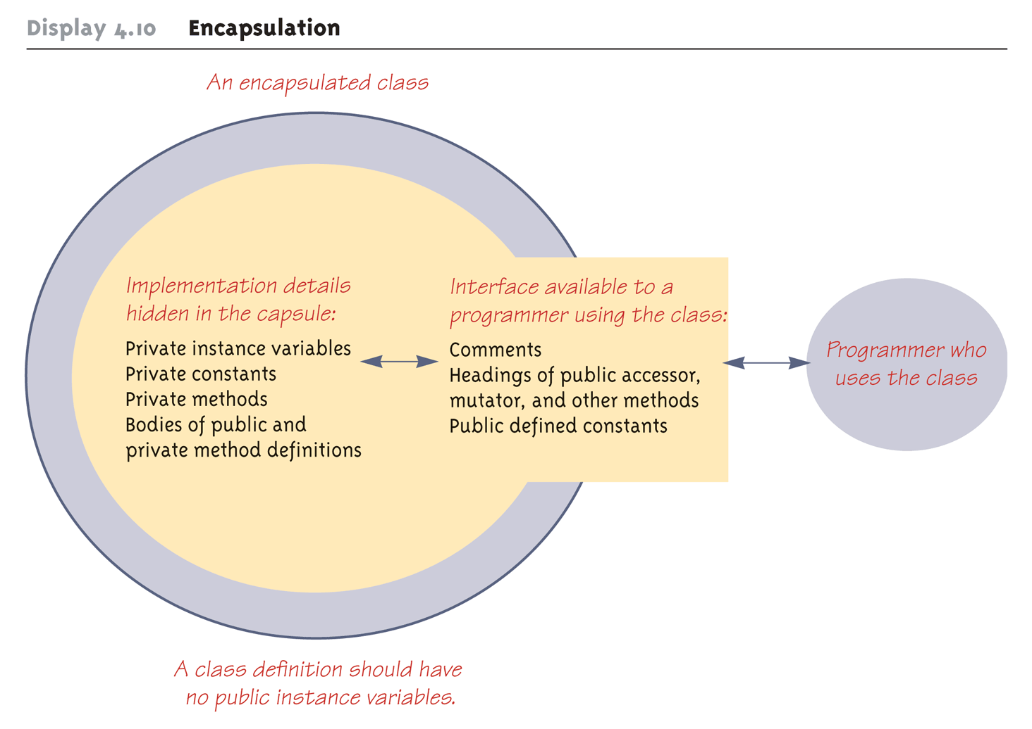
Encapsulation

Slide 61
Overloading
Overloading is when two or more methods in the same class have the same method name
To be valid, any two definitions of the method name must have different signatures
A signature consists of
the name of a method together with
its parameter list
Differing signatures must have different numbers and/or types of parameters

Slide 62
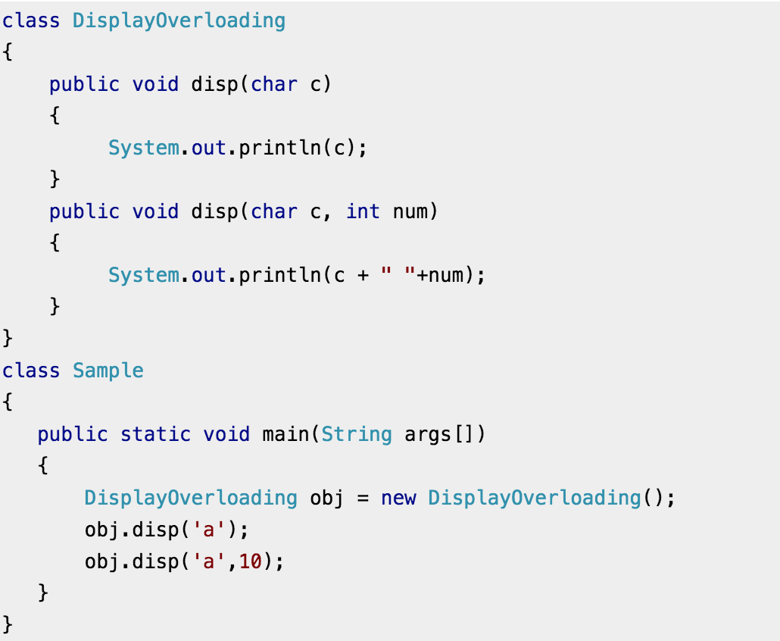
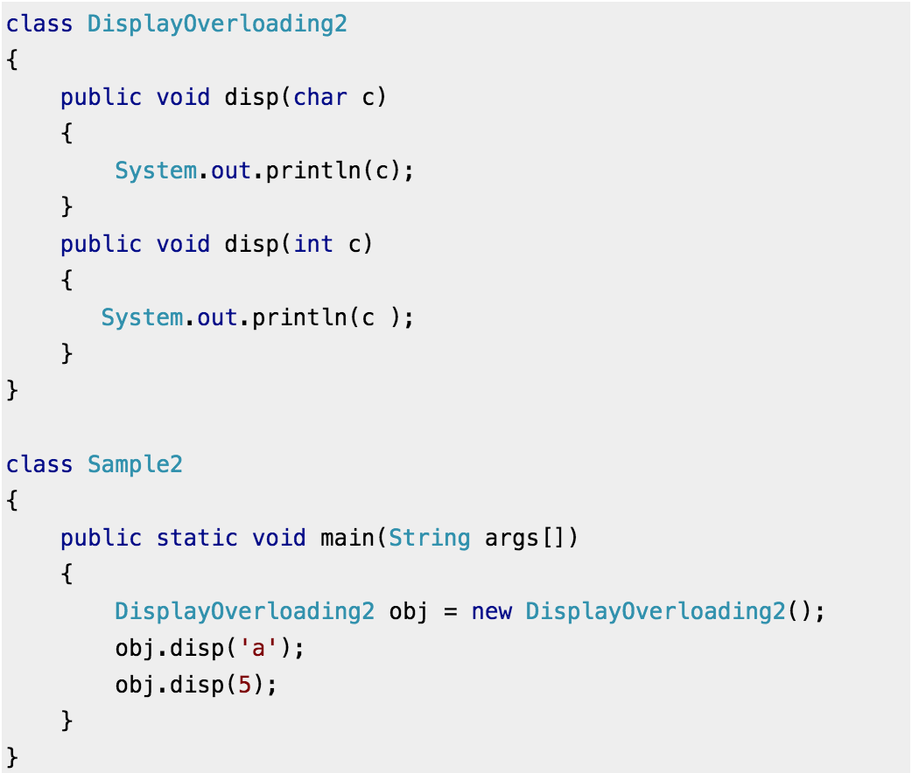
Overloading

Slide 63
Overloading and Automatic Type Conversion
If Java cannot find a method signature that exactly matches a method invocation, it will try to use automatic type conversion
The interaction of overloading and automatic type conversion can have unintended results

Slide 64
Pitfall: You Can Not Overload Based on the Type Returned
The signature of a method only includes the method name and its parameter types
The signature does NOT include the type returned
Java does not permit methods with the same name and different return types in the same class

Slide 65
You Can Not Overload Operators in Java
Although many programming languages, such as C++, allow you to overload operators (+, -, etc.), Java does not permit this
You may only use a method name and ordinary method syntax to carry out the operations you desire

Slide 66
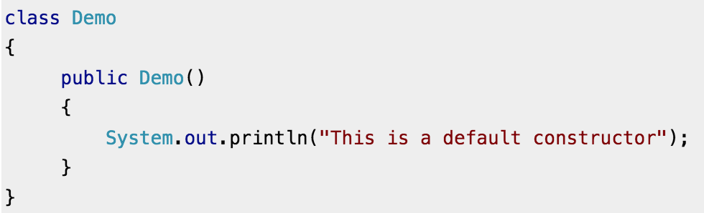
Constructors
A constructor is a special kind of method that is designed to initialize the member variables for an object:
public ClassName(anyParameters){code}
A constructor must have the same name as the class
A constructor has NO type returned, not even void
Constructors are typically overloaded

Slide 67
Constructors
A constructor is called when an object of the class is created using new
ClassName objectName = new ClassName(anyArgs);
The name of the constructor and its parenthesized list of arguments (if any) must follow the new operator
This is the only valid way to invoke a constructor: a constructor cannot be invoked like an ordinary method

Slide 68
You Can Invoke Another Method in a Constructor
The first action taken by a constructor is to create an object with instance variables
Therefore, it is legal to invoke another method within the definition of a constructor, since it has the newly created object as its calling object
For example, mutator methods can be used to set the values of the member variables
It is even possible for one constructor to invoke another

Slide 69
A Constructor Has a this Parameter
Like any ordinary method, every constructor has a this parameter
Then within the definition of a constructor, the this parameter refers to the object created by the constructor

Slide 70
Include a No-Argument Constructor
If you do not include any constructors in your class, Java will automatically create a default or no-argument constructor that takes no arguments, performs no initializations, but allows the object to be created
If you include even one constructor in your class, Java will NOT provide this default constructor
If you include any constructors in your class, be sure to provide your own no-argument constructor as well

Slide 71
Default Variable Initializations
Member variables are automatically initialized in Java
boolean types are initialized to false
Other primitives are initialized to the zero of their type
Class types are initialized to null
However, it is a better practice to explicitly initialize instance variables in a constructor
Note: Local variables are NOT automatically initialized

